Slide 1
CCH Tagetik Predictive Extended Planning
Value Proposition
Messaging
Customer Pain Points
Sales Motions
Jan 2025

Slide 2
Agenda
Where we win and lose (slide 3)
Overview Ideal Customer Profile and Buying Team (slide 4, 5)
Planning Challenges (slide 6 - 9)
Solution and Differentiators (10 - 14)
Solution Value (15 – 19)
Sales Motions (20-27)

Slide 3
Executive summary | Success in Planning
Requires aligned Strategy paired with Investment, Enablement & Skill-building
Focus on selling Planning as part of Office CFO platform
Position & sell CCH Tagetik Budgeting & Planning as the best solution in market for Group Level budgeting & planning and for xP&A
Success Priorities
Strategic Decision alignment: Focus on Finance-led Planning – and/or –
Focus on xP&A planning expansion across Conglomerates
ENABLEMENT
Insights: Based on win-loss data from 2023 and 2024, Target sales to finance-led ICPs in key industries while Roadmap is clarified
Selling Now: Focus on Predictive Planning to stir differentiation & demand while solving for scenario planning roadmap
Enable Sales/Pre-Sales: Conduct regular Sales Booster sessions, refresh sales tools, competitive and marketing content on community
INVESTMENT
Roadmap: Balance resources across Planning, AIH and Platform to prioritize Scenario Planning & user experience to align with strategy
Demand for Custom Demos, POCs: Improve demo resources
Referenceable customers: Remove blockades to grow referenceable customer pool & improve ease of access
WHY WE WIN
When buyer seeks finance-led / group-level budgeting & planning to complement FC&C
When buyer has clear vision for xP&A or IBP guiding decision
When buyer values using one-source-of-truth data
WHY WE LOSE
When buyer focuses on extending planning to BU-level planners with diverse requirements – complexity is a blocker
When buyer demands Scenario modeling (currently ‘table stakes’) we can’t demo effectively on the fly or showcase complex models
When POCs cannot easily support complex business requirements
Notes:
Sales Council
Executive sponsors: Kiran, Krista
Team: Michael Conley, Tom McDonough, GTM team member, 2 Planning pre-sales experts. Ideally to include Rob K or Caitlyn H as well

Slide 4
Ideal Customer Profile
Persona
Group Level Planning Executives and Planners
Office CIO*
Go to market:
Extend/Expand with existing customers
Land New Accounts
Target SAP Accounts for BPC Replace
Target Industries
Manufacturing (Auto, CPG, Industrial)
BFSI
Services
Company Size €500MM and above
*It’s critical to compete by differentiating as a unique full-service platform for office of the CFO:
Close & consolidation, planning, tax, regulatory and ESG

Slide 5
The stakeholders influencing the buying process
CFO | IT Buyer | FP&A | Controller
Key Characteristics Overwhelmed by complex financial reporting, planning, and compliance, compounded by data silos and manual processes. Needs real-time insights for strategic decisions but hindered by sprawling plans and data across the organization Sceptical of vendors due to past failures, prioritizing transparency and ROI. Concerned about talent gaps and the need for digitally skilled staff. | Key Characteristics Align finance systems with IT strategies Minimize security risks Ensure global compliance Streamline operations, deliver cost-effective solutions with clear ROI Implement scalable, growth-ready systems. | Key Characteristics FP&A drives strategic financial management, leveraging models and data analytics to prepare budgets, forecast trends and inform senior management decisions. Key Responsibilities Budgeting: Align plans across functions Planning: Continuous monitor execution to plan Forecasting: Predict financial outcomes Strategic Analysis: Evaluate trends for decision making. Shape financial strategy with insights. | Key Characteristics Ensures accuracy, compliance, and integrity of past and present financial data. Oversee operations, accounting, risk management, internal controls, and reporting for management and investors Maintaining budget discipline while contributing to strategic decisions and emphasizing historical records Depend on plan results for reporting Determine the baseline for next planning cycles
Concerns Fear of missing planning deadlines due to plan and data sprawl across the organization Unable to convert work efforts from plan readiness to analysis and projection Frustrated by unreliable data and outdated systems Pressured to automate and understand new trends in technology such as Gen and Objective AI Management pressure to lead corporate strategy from a financial perspective | Concerns Legacy Systems: Struggling with integration of old systems and new SaaS solutions Proliferation of solutions and data: Multiple support contracts and data extraction requests put strain on budgets. Must balance quality solutions with limited resources. Stakeholder Alignment: Aligning technical needs with business objectives and expectations. Rapid Tech Evolution: Staying current with tech trends to avoid obsolescence. | Concerns Productivity: Challenged to automate data and plan integration for planning readiness Adoption of technology: Understand the pace of change in technology is happening but lack trusted advisors Lacking insights: Forecasts drive investments. Inaccurate forecasts could mislead decisions, harm strategy, and damage credibility. Lack of Alignment: Misalignment with other departments risks decisions based on incomplete or misleading data. | Concerns Financial controllers inform the CFO, the CEO and ultimately, investors. Fear inaccuracies, non-compliance, missed deadlines, capex issues, cash flow issues, profitability issues, failed audits, and inaccurate forecasts.
How We Help Single source of truth, proactive insights, and a strategic partner for change. | How We Help Unified solutions for the Office CFO on a single platform. Future-ready with AI, and pre-built connectors to reduce integration costs and complexity. Lower maintenance and support. | How We Help Data collection and consolidation, scenario planning for agility, data visualization for clarity,workflow and collaboration for alignment and AI to free up time for strategic work | How We Help Automates and integrates all financial processes into a unified platform, eliminating manual tasks and and integrated compliance support...

Slide 6

Planners are challenged with turning data into decision support information
Where is my data?
Can I automate report generation for my operational counterparts?
What’s the navigation path I have to follow to access the report that I need?
How do I align my plans with CFO strategy?
85%
How can I build the right data sets to support the scenarios I’d like to examine?
How do to explain my performance more clearly?
Planners struggle to support growing peer and management analysis requests*
*Gartner Nov 2024 – Gartner says Finance and analysis teams need to rethink partnering in a digital function
Confidential under the terms of our service agreement
Notes:
In our work with global CFOs, we see they’re under tremendous pressure to optimize – and balance new demands for information and answers. At the root of their challenges? Up to 80% of the data is inaccessible - hundreds or even thousands of source systems – in formats that aren’t compatible with existing solutions.
With the current AI trend, unstructured data keeps growing - 65% annually. So, planners are spending more time than ever before just extracting and processing data – not analyzing. That’s why we developed AI solutions to free time – to help finance find the answers they need.
40 seconds

Slide 7
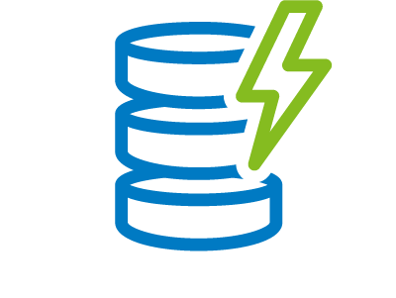
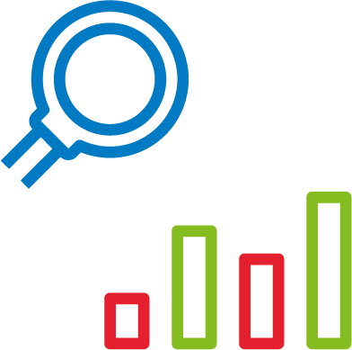
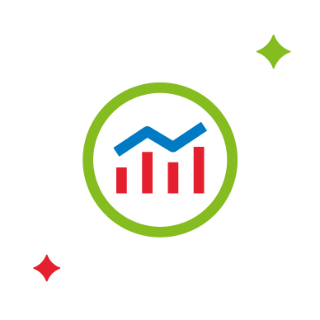
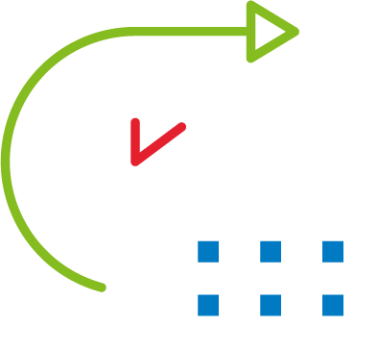
CPM Platform Feature Adoption Slowed by Data Integration Challenges*
Planned feature adoption is focused on integrating capabilities
Self-service planning in the cloud
Integrated planning & consolidation
Integration of operational sub-plans
Predictive planning & forecasting and AI
Integration of planning with BI/Analytics
Scenario & driver-based analysis
*BARC: Global CPM Trends and Priorities Report 2025
Confidential under the terms of our service agreement
Notes:
In a December 2023 story in Fortune magazine, a Fortune 500 company survey disclosed that the average tenure of a CFO has declined by 10% since 2018. Given the pressure to perform and deliver, what are CFO focused on?
The features/capabilities highlighted on this slide represent the areas of focus highlighted by a BARC research survey with CFOs done in the past 6 months
2 important takeaways I’d like to highlight
We provide all these capabilities in our current product offering
It’s important to find buyers who agree with the concept of a controlled rollout of product, focused on corporate objectives first. The integration challenges are minimized through this approach

Slide 8
The challenges of Fragmented Planning stems from business unit & departmental data silos
The current situation, where data essential for management decisions is fragmented and requires significant effort to integrate, severely constrains companies' strategic decision-making capabilities.
Overcoming these challenges and enhancing management agility has become crucial for corporate success. Challenges include:
Delayed decision-making due to data fragmentation:
Companies are spending significant time integrating information necessary for management decisions due to dispersed systems and files across departments and group companies. Real-time data integration remains unachieved, making it difficult to make decisions based on the latest information.
Increasing complexity of KPI management in Group operations:
For globally operating companies, KPI management across departments and regions has become increasingly complex. Non-standardized evaluation criteria make it difficult to conduct consistent assessments between group-wide and individual business units, hindering optimal resource allocation.
Limitations of analysis capabilities:
Existing systems lack sufficient capabilities for cross-analysis and complex simulations. Additionally, the difficulty in integrating financial and non-financial data, coupled with time-consuming data processing, impedes swift management decision-making.
Notes:
So lets return to what keeps our customers and prospects up at night. We refer to it as Fragmented Planning.
CLICK Delayed Decision Making due to data fragmentation – this is somewhat self explanatory but what decision delays implies is that money and employee time are not spent effectively
Click: Increasing complexity of KPI management in group operations – We’ll talk about this again in this presentation. At a high level – divisions and business units need to roll seamlessly into corporate systems. Focusing at the business unit or division level and expanding into corporate can lead to significant re-design costs. Also as we’ll talk about later – it can reduce agility and add unnecessary cost to your subscription in data and users.
Click: Limitations of analysis capabilities – You all know that we offer predictive analytics and that this can almost be considered table stakes with key competitors. Another way to look at this is the impact fragmented systems have on the ability to use the analysis tools we sell. You own it but you can’t get the time into utilizing it due to fragmented data and systems.
66 seconds

Slide 9
Office of CFO
“Provide my team the capability to securely, accurately, and rapidly understand the current state and influence the future direction of the financial performance of our business”
Fragmented Planning Limits CFO Capabilities
Pressure to adapt plans to
dynamic business environments and build trusted future projections
Leverage vast, hard to access data to optimize recommendations for measuring & tracking performance
Align resources to strategy to deliver informed outcomes while executing with confidence, speed and agility
Notes:
As you read through the perspective of the office of the CFO on what planning products need to support, keep in mind the political nature of the position. A key differentiation when selling planning vs. close and consolidation or tax solutions is that planning outcomes aren’t fixed – they are data driven but involve subjective decision making as well.
What makes that challenging for your customers is the level of fragmentation – fragmented plans and data, creating an environment where they need to
Click 1: Pressure to adapt plans to dynamic business environments and build trusted future projections
Click 2: Leveraging vast, hard to access data for measuring & tracking performance
Click 3: Align resource to strategy to deliver outcomes while executing with confidence, speed and agility
52 seconds

Slide 10


CCH Tagetik addresses key customer challenges
Execute more accurately and gain visibility into key drivers and trends across finance and operations
Accelerate budgeting and planning with intelligent data management and drive improved decisions with Gen AI
CUSTOMER CHALLENGES
Data Readiness
Alignment
Visibility to Root Causes
Explainable Results
Plan & Data Sprawl
Enhanced Insights
Time-to-Value

Slide 11
CCH Tagetik’s top 3 differentiators
The Intelligent Platform infuses AI across Extended Planning capabilities
AI-based Intelligent Foundation assimilates data for secure planning & analysis
Intelligent Analytics with GenAI help finance unlock answers trapped in data
Extended planning & IBP for driving strategic decisions & financial results
&nbsp;
Notes:
Our top 3 differentiators for Extended Planning will focus on how we are:
First - Leveraging AI to provide planners faster and more accurate access to key planning information with Generative AI and Intelligent Analytics
Second - Innovating the capabilities of our extended planning solution to improve the speed and accuracy of planning, and
Third - Providing an intelligent foundation for faster analytical tools in getting the data that planners need to make informed decisions
20 seconds

Slide 12
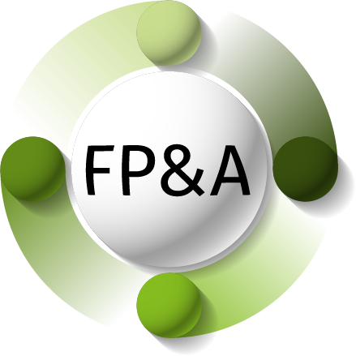

CCH® Tagetik Extended Planning
Predictive Agile Planning on an Intelligent Platform
OPTION 3
Integrated Business Planning
Budgeting Planning and Forecasting
Supply Chain Planning
Financial Close & Consolidation
Demand Planning
Supply
Planning
Sales &
Operations Planning
Supply Chain Planning
Cash Flow
Planning
Production Cost
Planning & Control
Workforce Planning

Slide 13
AI Innovation Resolves Fragmented Planning
Pressure to adapt plans to
dynamic business environments and build trusted future projections
Leverage vast, hard to access data to optimize recommendations for measuring & tracking performance
Align resources to strategy to deliver informed outcomes while executing with confidence, speed and agility
73% of finance functions favor a centralized, tightly governed source for data…but it can cause data to be out of date, inconsistent or incomplete*
* The Gartner CFO Report
OBJECTIVE
AI
IBP
GEN
AI
Notes:
Referring back to some of customers primary challenges, our intelligent platform, when combined with IBP provides a complete solution for Fragmented Planning
That’s a lot of marketing speak so let me break it down
Much of our Foundational Layer of Objective AI is designed resolve data quality issues in planning. In my experience data issues reduce the ability to pull together and analyze the plan through scenarios, reducing agility
As shown in some of our examples, being able to integrate business planning to align key drivers to strategic objectives is a key to business and personal success for our customers
Our Ask AI technology helps build reports from vast amounts of data for measuring and tracking performance to plan, an activity which aligns resources to strategy and improves confidence
52 seconds

Slide 14
CCH Tagetik Defeats Fragmented Planning with Controlled Agility
Combine department granular planning with corporate planning and governance
Global framework
Governance at the
Global level
COMMON DATA MODEL
STANDARD REPORTING FORMULAS
DRILL THROUGH TO ANALYTICAL LAYER
PREDEFINED
Division 1
Geography 1
Division 2
Geography 2
COMMON DATA MODEL
STANDARD REPORTING FORMULAS
DRILL THROUGH TO ANALYTICAL LAYER
Flexibility at the
Local level
Notes:
Returning to this concept of Controlled Agility in Planning. If you have a chance to talk with Patrick or anyone on the Tesco sales team, you’ll know competing with Anaplans Connected Planning can be very challenging. This is why I consider this a great win for us
A key counterpoint to connected planning is to lead the conversation with your customers and prospects about the importance of defining corporate goals for planning systems and following those designs to ensure
Click – Governance. This means the corporate KPI and structure of their planning models are defined and built to meet the Office of the CFO needs ..then
Click – rolled out to divisions or geographies where flexibility can be built in locally
I talk about this in a little more detail in the compete section coming up momentarily
46 seconds

Slide 15
Why Should CFO's care about
CCH Tagetik Agile Planning?
Aligning multiple plans accurately across vast data requires an Intelligent Platform
OPTION 2
OPEX
10-20%
Budgeting Planning and Forecasting
Cash Flow Planning
Workforce Planning
Budgeting Planning and Forecasting
CAPEX
5-15%
Capex Planning
Cash Flow Planning
Gross margin
25-29%
Profitability Analysis
Revenue growth
10-31%
Production Cost Planning
& Control
Working capital
25-30%
Workforce Planning
Asset utilization
32-49%
Sales & Operations Planning
Demand plan accuracy
18-43%
Demand Planning
Supply Planning
Order fill rate
29-34%
Capacity Planning
Notes:
I want to talk a little bit about why CFO’s should care about CCH Tagetik Agile Planning.
I’ll tie this back to some of the research tips we discussed earlier in the presentation with existing customers UniCredit, Japan Airlines and Toyota.
Somewhat obviously I’ve stated they need to align multiple plans accurately across vast data which increasingly requires an intelligent platform… but that begs the question of how do we convey that we can do this
These KPI highlighted in the blue boxes have been assembled from a number of credible sources and represent the benefits companies have attained from integrated business planning. Integrating financial plans with operational or supply chain plans.
CLICK – Recalling the UniCredit case where they were focused on attaining that operating expense KPI, the key drivers would come from cash flow and workforce planning
CLICK and we would want to position this as a solution after our due diligence to understand their strategic goals
57 seconds

Slide 16
Why Should CFO's care about
CCH Tagetik Agile Planning?
Aligning multiple plans accurately across vast data requires an Intelligent Platform
OPTION 2
OPEX
10-20%
Budgeting Planning and Forecasting
CAPEX
5-15%
Budgeting Planning and Forecasting
Capital Expense Planning
Production Cost Planning & Control
Capex Planning
Cash Flow Planning
Gross margin
25-29%
Profitability Analysis
Revenue growth
10-31%
Production Cost Planning
& Control
Working capital
25-30%
Workforce Planning
Asset utilization
32-49%
Sales & Operations Planning
Demand plan accuracy
18-43%
Demand Planning
Supply Planning
Order fill rate
29-34%
Capacity Planning
Notes:
If, instead, a customer like Toyota is spending massive amounts on capital equipment to achieve strategic goals
CLICK – we would want to position capital expense and possibly production cost planning and control
Click – keep in mind that these solution sets aren’t fixed, they can vary. For example, they may want to have better utilization of capital equipment in which case we may be talking about improving demand and/or supply planning
26 seconds

Slide 17
Why Should CFO's care about
CCH Tagetik Agile Planning?
Aligning multiple plans accurately across vast data requires an Intelligent Platform
OPEX
10-20%
Budgeting Planning and Forecasting
Cash Flow Planning
Workforce Planning
Budgeting Planning and Forecasting
CAPEX
5-15%
Budgeting Planning and Forecasting
Cash Flow Planning
Production Cost Planning & Control
Capex Planning
Cash Flow Planning
Gross margin
25-29%
Budgeting Planning and Forecasting
Profitability Analysis
Profitability Analysis
Revenue growth
10-31%
Budgeting Planning and Forecasting
Sales & Operations Planning
Production Cost Planning
& Control
Working capital
25-30%
Budgeting Planning and Forecasting
Production Cost Planning & Control
Demand Planning
Workforce Planning
Asset utilization
32-49%
Production Cost Planning & Control
Sales & Operations Planning
Sales & Operations Planning
Demand plan accuracy
18-43%
Production Cost Planning & Control
Demand Planning
Demand Planning
Supply Planning
Order fill rate
29-34%
Sales & Operations Planning
Demand Planning
Supply Planning
Capacity Planning
Notes:
And finally, in the case where a customer wants to improve gross margins, as was the case with Japan Airlines
Click – we would want to position Profitability Analysis with Budgeting, Planning and Forecasting
The examples continue but we won’t spend time on them today. We are looking at putting together brief training videos as collateral for the Sales Kits
20 seconds

Slide 18
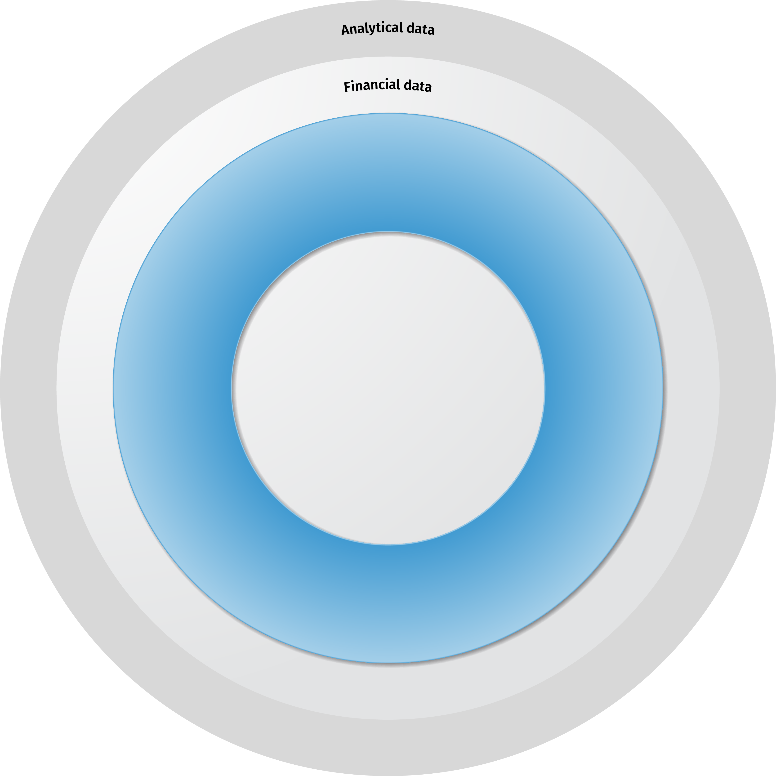
Agile Planning Requires Core Platform Features with Intelligence
Reporting and analytics, dashboards, variance analysis, scorecard, performance reporting, visualization tools
Analytic Information Hub
data transformation, organization and scenario modeling and extensibility
Scenario
planning
& analysis
Budgeting & Forecasting
CCH Tagetik Budgeting
Planning & Forecasting
AI-based Intelligent Foundation assimilates data for secure planning & analysis
Workflow &
collaboration
tools
Security & Compliance
Intelligent Analytics with GenAI help finance unlock answers trapped in data
Management
Reporting
Core Platform Features
Extended planning processes
Notes:
As we focus our sales on the Office of the CFO, Budgeting Planning and Forecasting will be our primary entry point. Keep in mind the fact that we sell better as a platform when approaching new customers.
We discussed differentiators in our selling based on the data we looked at and the platform is a key one, as are the GEN and OBJECTIVE AI capabilities we’ve introduced in the past year
This presentation formatting lines up with our other lines of business and should make it easier to develop presentations to have and discuss interdependencies
33 seconds

Slide 19
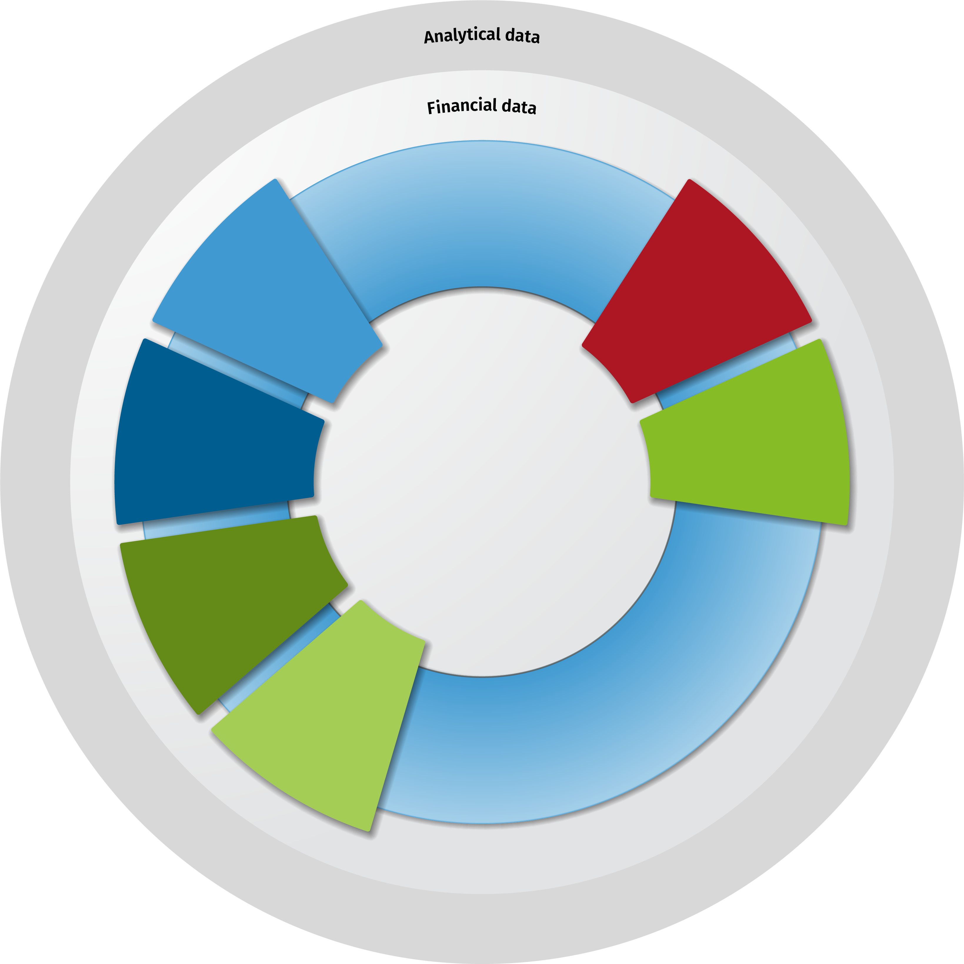


Agile Planning to improve the accuracy and speed of planning results
Reporting and analytics, dashboard, variance analysis, scorecard, performance reporting, annual report
Analytic Information Hub
data transformation, modeling,
and extensibility
Scenario
planning
& analysis
Revenue
Forecasting
Cap Ex
Planning
Integrated Business Planning
Workforce
Planning
Production Cost
Planning &
Control
Extended Planning
Demand & Supply
Planning
Leverage Integrated Business Planning to drive strategic decisions & financial results
Workflow &
collaboration
tools
Profitabilitv
Planning
Align corporate and divisional planning
Incorporate core cost and revenue drivers into plans
Drive scenarios toward highly variable operations
Budgeting
Integrated
Eco Planning
Cash Flow
Planning
Management
Reporting
Core financial
planning processes
Extended planning processes
Notes:
When discussing Agile Planning with customers or prospects, we introduce this concept of Agile Planning. Recall that our third differentiated selling approach – along with the platform and intelligence in the platform was referred to as controlled agility. We’re going to discuss tha in more detail in a moment
For existing BP&F customers we want to talk about EXTENDING their existing financial planning into adjacent but interconnected planning areas.
In all the case studies we looked at the customers knew that their revenue and costs were dependent on drivers and visibility and control of these drivers gives them more control over outcomes.
Driving improvements to OPEX with Workforce or Cash flow planning for example
45 seconds

Slide 20
Selling Agile Planning as the Unique Selling Proposition

Slide 21
Ideal Customer Profile
Remove selling complexity, leverage product strengths and existing relationships
Geography
Company Profile
Industry
Buying Profile
Pain Points
Existing FCC customer expand to FP&A | Global | Targeted list of Global FCC Customers | Manufacturing Consumer Goods BFSI Professional Services Energy/Telco | Enterprise but using older systems or Excel for Planning Express interest in better understanding benefits of AI Existing executive sponsors willing to make an introduction to Planning leadership | Need for better cross functional collaboration Unhappy with IT data management solutions or .too many systems
BP&F/FP&A Land | Global | >500MM Multinational Division of multinational | Manufacturing Consumer Goods BFSI Professional Services Energy/Telco | Enterprise but using older systems or Excel for Planning Express interest in better understanding benefits of AI New RFP Have SAP | Can't respond to change quickly and effectively Interested in being able to run more scenarios within planning cycles Current vendor unresponsive
BP&F/FP&A Expand with IBP | Global | >500MM Multinational Division of multinational | Manufacturing Consumer Goods Energy/Telco | Enterprise but using older systems or Excel for Planning New RFP | Evidence of Operational performance issues Finance visibility problems to operations

Slide 22
Selling Predictive Extended Planning
5 Sales to Support 3 Sales Motions
EXISTING CUSTOMERS
NEW CUSTOMERS
EXPAND
Unify Financial Consolidation and Planning
EXTEND
Extended Planning for Finance
LAND
Budgeting, Planning and Forecasting
Positioning Budgeting & Planning to our FC&C customers
Positioning Extended Planning
Positioning for Budgeting Planning and Forecasting prospects
H1 2025
H2 2025
SAP Migration Sales Play
FP&A – IBP
SCP - IBP (to FP&A to other SCP)
Predictive Extended Planning
1
3
5
Expand to Planning
FP&A Extend
S&OP
2
4
FP&A – Cash Flow
Demand Plan
FP&A – Profitability
Supply Plan
FP&A – PC&C
Inventory Plan
FP&A – Cap Ex
Capacity Plan
FP&A – HR/Op Ex
Notes:
Finally, we’ve gone through the effort of creating positioning and messaging documents for 5 sales plays based on this enablement and GTM presentation
In selling Agile Planning to existing customers, we can help them EXPAND their existing Close and Consolidation into Financial Planning. We have one of these documents for those cases where you are talking with SAP customer considering S/4 Hana migration and another for existing Close & Consolidation customers – the better together platform message we’ve talked about
We have two additional sales plays focused on helping customers EXTEND their existing BP&F into adjacent financial planning solutions or into SCP via Integrated Business Planning. Product will be releasing and highlight IBP in more detail toward the end of Q1
Finally, for landing new prospects on Predictive Extended Planning, the messaging and positioning document looks like this
60 seconds

Slide 23

Positioning Budgeting & Planning to our FC&C customers on legacy SAP
Positioning for EXISTING CUSTOMERS
1
ELEVATOR PITCH
KEY VALUE DIFFERENTIATOR:
Legacy BPC on ECC (on-premise SAP ERP) customers are actively migrating from BPC on Business Warehouse (BW – SAP’s AIH equivalent) to SAP Analytical Cloud (SAC) for Planning and to Group Reporting on SAP 4/HANA for Consolidation. The transition is slow because of missing capabilities in the cloud.
Known challenges:
Data entry in SAC is challenging; it’s similar to Power BI but not as easy. As a BI tool it misses key logic like double-sided journal entry – one side is cash, other sales. This configuration must be built by a modeler.
Currency conversions for cash flow for example are difficult to handle
Supplemental build outs in Group reporting requires they also buy Business Process software BPP. Supplemental templates are out of the box in CCH Tagetik
Similarly, have to buy Inter Company Transaction Matching (ICTM) separate from Group Reporting (GR)
BEST-FIT PLANNING SOLUTION FOR BPC CUSTOMERS
Tightly integrated to FC&C on a powered by SAP 4/HANA platform, CCH Tagetik Budgeting & Planning delivers predictive, agile planning to current CCH Tagetik customers, delivering one source of truth and increased alignment and confidence for Financial Close & Consolidaton and Planners
KEY BENEFITS
SAP Integrated
Accuracy & Control
Innovation
Pre-built connectors directly connects CCH Tagetik Planning to SAP source systems via S/4 Hana reducing implementation times and increasing performance
More accurate financial planning and close processes are mutually beneficial, improving stakeholder confidence, employee productivity and overall business performance
AI assisted workflow in reporting and complex business processes improves productivity and continuously improves the ability to adapt to change and improve guidance for stakeholders
WHAT IS IT
HOW DOES IT HELP
An intelligent platform which unifies data management, workflow and shared close, consolidation and planning processes
Speeds time to close, reporting and planning accuracy in processes shared between planners and accountants
WHO TO SELL TO
COMPELLING EVENTS
CFO, CIO, VP Financial Planning, Accounting Chief, Controlling Chief, Head of Reporting
With the SAP migration you have to align your business to four development and release cycles: BW, S/4 Hana, SAC and GR.

Slide 24
Positioning Extended Planning to our FC&C customers
Positioning for EXISTING CUSTOMERS
2
ELEVATOR PITCH
KEY VALUE DIFFERENTIATOR:
Financial Planners strive to improve the accuracy and speed of planning while generating plans which are easy to understand and provide guidance for executives
No other Financial Planning vendor offers the Office of the CFO a full suite of Planning, Close & Consolidation, Tax, Regulatory and ESG solutions with robust Artificial Intelligence capabilities to empower Planners to meet the challenges now and in the future
Quality of shared process and data between close and planning has a direct impact on the ability of both accountants and planners to drive confident reporting and projections
Known challenges:
Too much time dedicated to data management and plan preparation
Multiple systems, user interfaces and integrations across the finance group inhibits accuracy, speed and collaboration
Improving governance and collaboration with guided workflow and issue resolution
Limited guidance and tools available for confidently adopting artificial intelligence
BEST-FIT PLANNING SOLUTION FOR CLOSE AND CONSOLIDATION CUSTOMERS
CCH Tagetik customers benefit in multiple ways from unified close and consolidation and financial planning on an intelligent platform. Processes and employees are more efficient and accurate. Improved results and agility builds confidence with key stakeholders
KEY BENEFITS
ACCURACY
CONTROL
INNOVATION
More accurate financial planning and close processes are mutually beneficial, improving stakeholder confidence, employee productivity and overall business performance
Managed workflow and collaboration on a unified platform improves governance and adherence to regulatory and business objectives
AI assisted workflow in reporting and complex business processes improves productivity and continuously improves the ability to adapt to change and improve guidance for stakeholders
WHAT IS IT
HOW DOES IT HELP
An intelligent platform which unifies data management, workflow and shared close, consolidation and planning processes
Speeds time to close, reporting and planning accuracy in processes shared between planners and accountants
WHO TO SELL TO
COMPELLING EVENT
CFO, CIO, VP Financial Planning, Accounting Chief, Controlling Chief, Head of Reporting
Increasing capabilities and adoption of AI benefits from unified data and processes across Finance and the entire business

Slide 25
Positioning Extended Planning to our FP&A customers through the IBP starter kit
Positioning for EXISTING CUSTOMERS
3
ELEVATOR PITCH
KEY VALUE DIFFERENTIATOR:
With thousands of planning customers worldwide, CCH Tagetik provides a trusted, AI-based corporate performance management platform for the Office of the CFO and key business partners in Operations and Supply Chain partners from across the enterprise
CCH Tagetik customers succeed in aligning plans in ways that improve planning accuracy and speed. Our intelligent platform provides AI-based tools to support competitive differentiation in predictive planning and development and analysis of best-fit plans
Known challenges:
Financial planners can’t assess operational performance in a time frame that supports effective adaptation of financial plans (e.g. what are my inventory positions?)
Operational planners can’t roll down cost adjustments in time to meet budgeted targets
Too much planner time is spent in data management, plan alignment and report building
Coordinated response to operational events is slow and often less informed than it should be due to incomplete data
EXTENDING FINANCIAL PLANNING FOR OPERATIONAL INSIGHTS
Integrated Business Planning enhances Financial Planning insights which drive continuous improvement and, through guided workflow and collaboration, facilitates successful management of cross functional initiatives such as product launches and workforce management. Research has shown these projects often fail due to scope and scale but that when they succeed they can deliver tremendous value. The CCH Tagetik Integrated Business Planning Starter Kit is designed to reduce risk and accelerate deliverables in these complex projects.
KEY BENEFITS
ACCURACY
CONTROL
INNOVATION
More accurate financial planning is highly dependent on more accurate operational plans as inputs. Having integrated plans and reporting facilitates better visibility, more agility and increased collaboration
Aligning plans and achieving goals requires self-regulating workflow and visibility to in-process status. Flexible tools ensure one-off analysis is aligned, while delivering confidence-building results
AI-assisted workflow in complex business processes and reporting improves productivity and continuously improves the ability to adapt to changes and improve guidance for stakeholders
WHAT IS IT
HOW DOES IT HELP
An intelligent platform which unifies data management, workflow and shared close, consolidation and planning processes
Speeds time to close, improves planning accuracy in processes and improves reporting shared between planners
WHO TO SELL TO
COMPELLING EVENT
CFO, VP Financial Planning, Accounting Chief, Controlling Chief, Head of Reporting
Data and Plan Sprawl, often facilitated by competitive planning products, creates increased non-value add work on data prep

Slide 26
Positioning Extended Planning to our FP&A customers – Finance Extend
Positioning for EXISTING CUSTOMERS
4
ELEVATOR PITCH
KEY VALUE DIFFERENTIATOR:
With thousands of customers worldwide, CCH Tagetik provides a trusted, AI-based corporate performance management platform for the Office of the CFO and key business partners
CCH Tagetik customers succeed in aligning plans in ways that improve planning accuracy and speed. Our intelligent platform provides AI-based tools to support competitive differentiation in predictive planning, rapid plan assessment and easy to understand reports.
Known challenges:
Timely alignment of forecasts for financial objectives related to income, profitability, capex, opex and cash flow planning.
Adapting and balancing across functions to best align income and expenses projections with strategy
Too much planner time is spent in data management, plan alignment and report building
Coordinated response to operational events is slow and often less informed than it should be due to incomplete data
BEST-FIT PLANNING SOLUTION FOR BPC CUSTOMERS
Tightly integrated to FC&C on a highly-tested, proven SAP 4/HANA platform, CCH Tagetik Budgeting & Planning delivers scalable, predictive and agile planning to current CCH Tagetik customers.
KEY BENEFITS
ACCURACY
CONTROL
INNOVATION
Enhanced capabilities to focus more specifically on cash flow, profitability, capital expense and production cost planning and control
More focused, regular insights to key components of financial performance ensures financial planners are better able to understand and manage to goals
Objective AI capabilities to increase accuracy of forecasting within key areas of finance improve overall financial planning performance
WHAT IS IT
HOW DOES IT HELP
An intelligent platform which unifies data management, workflow and shared close, consolidation and planning processes
Speeds time to close, reporting and planning accuracy in processes shared between planners and accountants
WHO TO SELL TO
COMPELLING EVENT
CFO, CIO, VP Financial Planning, Accounting Chief, Controlling Chief, Head of Reporting
Increasing requirements for executing strategic planning options and the need to understand the contribution of inputs

Slide 27
CCH Tagetik: Agile Planning
Positioning for NEW CUSTOMERS
5
ELEVATOR PITCH
UNIQUE SELLING PROPOSITION – AGILE PLANNING
For VPs of Planning in the Office of the CFO, facing fragmented, inaccurate planning processes & needing to balance centralized control with business unit flexibility to ensure accurate, aligned and data driven plans. CCH Tagetik delivers Controlled Agility.
What is controlled agility? It empowers planning leaders to strike the perfect balance: centralize structured workflows & processes while enabling flexible, independent scenario planning for business units. The result? Accurate, aligned data that feeds into the bigger plan—driving smarter, faster decisions across the organization.
Key Benefits:
Digital Excellence: CCH Tagetik Budgeting & Planning users builds digital excellence across the business, helping analysts manage and explore data at scale using embedded GenAI and AI-driven workflows.
Faster time to value: Enterprises deploying Budgeting & Planning achieve a faster time to value, jumpstarting their productivity with industry and domain templates and routines, such as transaction matching to reduce errors.
On-the-fly Modeling: Planning and replanning with iterative & ad hoc modeling & scenario planning tools, templates & calculations.
Agile planning allows planning leaders to strike the perfect balance: centralize structured workflows & processes while enabling flexible, independent scenario planning for business units. The result? Accurate, aligned data that feeds into the bigger plan—driving smarter, faster decisions across the organization.
WHAT IS IT
HOW DOES IT HELP
Comprehensive planning platform unifying financial & operational planning
Structure financial & non-financial data into business intel for analysis & exploration
WHO IS THE BUYER
COMPELLING EVENTS
Corporate VP of Planning in the Office of the CFO
Planning leadership change. Incumbent vendor proposes a ‘better way’. Legacy solution replacement. Trusted partner intro. Technology innovation (AI)
KEY BENEFITS Delivered 2025
FASTER TIME TO VALUE
ON-THE-FLY MODELING
FINANCIAL & OPERATIONAL AGILITY
Industry templates; GenAI; Trx match to reduce data errors
Planning & replanning using iterative, ad hoc modeling & scenario planning tools & templates infused with AI
Managing data exploration & analysis at scale with embedded GenAI and AI-driven workflows
Notes:
Each document has an elevator pitch, the unique selling proposition and a description of benefits.
After reiterating that Planning is complex and difficult to execute and recognizing that this also makes it challenging to sell, we will continue booster sessions this year as able but feel free to reach out with questions or assistance on deals as you see fit.
And with that we’ll move into Q&A
25 seconds

Slide 28
Integrated Business Planning aligns the entire organization
Integrated Business Planning
Optimize operational efficiencies
Budgeting, Planning & Forecasting
Cash Flow Planning
Capital Expenses Planning
Workforce Planning
Production
Cost Planning & Control
Supply Chain Planning
Macro Business
Planning
Processes focused on financial performance
Processes focused on operational excellence
Fully Aligned Enterprise
Strategic / Long Range Plans
Revenue Planning
Balance Sheet Planning
Cash Flow Planning
OpEx / CapEx Planning
Workforce Planning
Production Cost Planning
Procurement/COGS
Sales & Service Planning
Demand Planning / Forecasting
Supply Planning / MEIO / Network
Production Planning
Lifecycle & Assortment
Aligned S&OP
IT / Support Planning
Capacity Planning
AI-based, predictive intelligence provides faster and better-informed decisions

Slide 29





Benefits of CCH Tagetik on SAP HANA
For Finance:
For IT:
High performance CPM
Fast cycles with no latency with CCH Tagetik on SAP HANA In-Memory platform
Built-in SAP Connector
Pre-built connectors reducing integration cost by 30%+ (SDI+SDA)
Real-time data access
Direct connection to SAP Source systems for financial & non-financial data
Natively runs on HANA
Ready to run on SAP HANA and integrate SAP products
Predictive ready
Granular data and high- performance engine based on SAP technology
Continuation of SAP Investment
Ensures technological alignment with SAP strategy and investment

Slide 30
Stronger Together: CFO and FP&A Interdependency
Open communication, shared goals and processes, and mutual trust enable the CFO and FP&A peers to work as strategic partners.
Strategic Planning | Budgeting and Forecasting | Performance and Monitoring | Decision Support | Risk Management | Stakeholder Communication | Team Leadership
The CFO sets the overarching financial strategy in alignment with corporate goals. FP&A peers oversee budget and forecast preparation, ensuring they align with strategic objectives. | The CFO sets priorities and approves budgets. FP&A peers deliver data-driven insights, models, and scenarios to shape the strategy. | The CFO monitors financial health through high-level KPIs. The Head of FP&A provides detailed analysis, highlighting trends, risks, and opportunities. | The CFO relies on FP&A peers for actionable insights on investments and cost-reduction initiatives. The Head of FP&A ensures recommendations are backed by robust analysis. | The CFO oversees enterprise risk management, supported by FP&A's scenario planning and stress testing.potential financial risks. | The CFO communicates financial results and strategies to stakeholders, supported by the Head of FP&A's detailed reports and analysis. | The CFO ensures alignment across finance, while the Head of FP&A drives process improvements and a culture of analytical excellence.
The Challenge Managing Complexity: Navigating complex data for financial models and forecasts can be frustrating when numbers don’t align or data is hard to gather. | The Challenge Siloed Data: Scattered data risks misleading decisions, harming strategy, and affecting financial results. Frequent errors further erode credibility within the team and company. | The Challenge Forecasting in Volatile Markets: Inaccurate forecasts and unpredictability disrupt financial plans, demanding sharper financial planning. | The Challenge Data Collection & Consolidation: Gathering data from disparate systems is time-consuming, increases errors, and compromises data analysis quality. | The Challenge Overlooking Critical Issues: FP&A professionals fear missing key financial indicators, trends, or risks, leading to poor decisions if not identified early. | The Challenge Stakeholder Communication & Alignment: FP&A teams struggle to convey complex financial insights clearly to non-financial stakeholders. | The Challenge Fear of Scrutiny: FP&A professionals fear intense scrutiny and criticism when presenting financial reports and projections to top executives.
The Opportunity A unified platform connects data from diverse sources, streamlines workflows, and enables predictive analytics to model scenarios and identify key business drivers. | The Opportunity Outdated tools and siloed data hinder FP&A insights. CCH Tagetik empowers teams to move beyond manual processes, enabling real-time, data-driven planning and forecasting. | The Opportunity Integrated financial planning software consolidates data into a single source of truth, improving accuracy and accessibility. Automation reduces errors and saves time. | The Opportunity Integrated financial planning software consolidates data in one place, ensuring accuracy and accessibility, while automation eliminates errors and saves time. | The Opportunity Integrated compliance support ensures automatic updates on regulatory changes, keeping financial processes and reports aligned with current laws and standards. | The Opportunity Data visualization tools transform complex data into clear, digestible reports and dashboards for better stakeholder understanding. | The Opportunity FP&A professionals take pride in delivering accurate reports and successful forecasts that drive key decisions and company success.

Slide 31
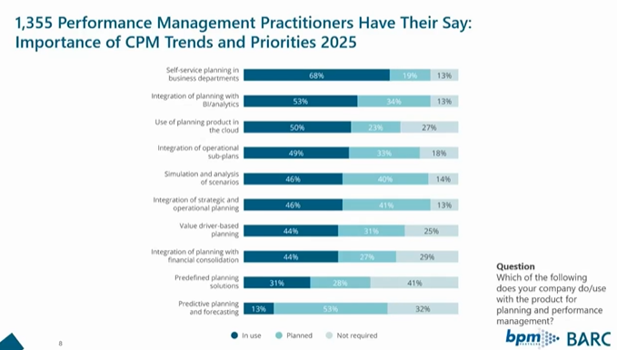

Slide 32
  Market's expectations for Extended Planning capabilities
  Key capabilities of xP&A and expected outcomes as this market matures include: Composable, modular approaches to xP&A for financial planning and analysis (FP&A) and operational planning solutions, with both being capable of scaling to meet organizational requirements
  Improved performance and infrastructure capable of supporting larger and more granular datasets
  Flexible solutions that enable operational teams to continue to work independently from finance on specific needs, while maintaining full alignment and focus on shared assumptions, drivers and key performance indicators (KPIs)
  Business value realized sooner, with lower custom coding requirements, by leveraging comprehensive, prebuilt composable solutions with pre-built workflow connectors and integrated with data from planning solutions
  Capabilities in support of powerful Artificial Intelligence and Machine Learning (AI/ML) algorithms that highlight anomalies and suggest actions across supported plans. These capabilities will also be expected to notify planners and decision makers of issues requiring action.
  Vendor- and partner- delivered horizontal and industry-specific operational planning solutions based on targeted markets
CCH® Tagetik Extended Planning

